Slide 1












MOVIE RECOMMENDATION SYSTEM USING
PORTER STEMMER ALGORITHM

Slide 2

NAME
A LATHIFUNISA TAUSIFA
NM ID
au412721205028
TAGORE ENGINEERING COLLEGE
COLLEGE

Slide 3

AGENDA
01
Problem Statement
02
Project Overview
03
End Users
04
Solution and Its value Proposition
05
The Wow in Solution
06
Modelling
03
Result

Slide 4


Problem Statement
Inefficient Movie Recommendations
User Dissatisfaction
Users are frustrated with irrelevant, outdated, or repetitive movie recommendations.
Existing recommendation systems fail to provide personalized and relevant movie suggestions.
Lack of Context Understanding
Systems struggle to understand the nuanced preferences and moods of individual users.

Slide 5

Project Overview
This project aims to create a sophisticated movie recommendation system.
Using innovative algorithms, the system will provide personalized movie suggestions based on user preferences.
The platform will employ advanced data processing techniques to enhance the user experience.

Slide 6



Who are the End Users
Personalized Experience
Community Recommendations
Mobile Accessibility
Users prefer a recommendation system accessible on-the-go via mobile devices.
Users seek tailored movie suggestions based on their preferences and viewing habits.
End users value suggestions from their social circles or like-minded movie enthusiasts.

Slide 7

Solution and Its Value Proposition
A movie recommendation system offers personalized suggestions based on user preferences, viewing history, and feedback. It enhances user experience and engagement, leading to increased user retention and satisfaction.
The system's value propositions include improved content discovery, personalized recommendations, and tailored user experience, ultimately driving user loyalty and platform engagement.

Slide 8

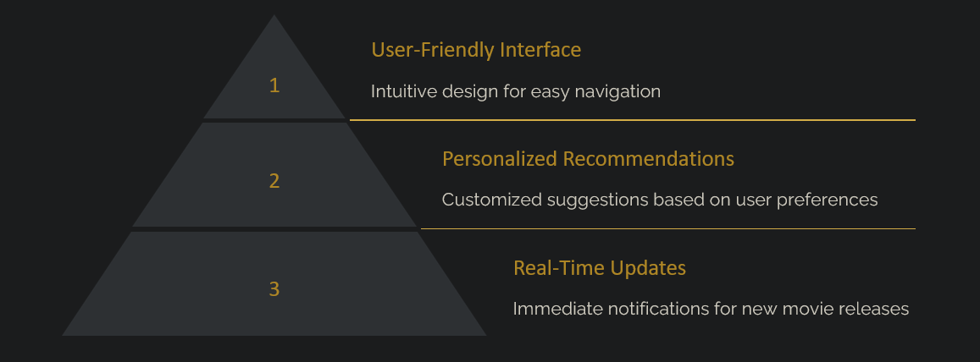
The Wow in Solution

Slide 9

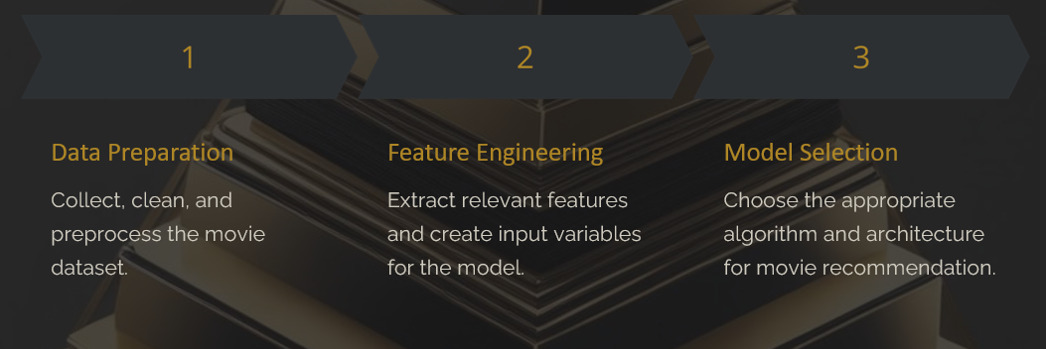
Modelling
Porter Stemmer Algorithm…

Slide 10
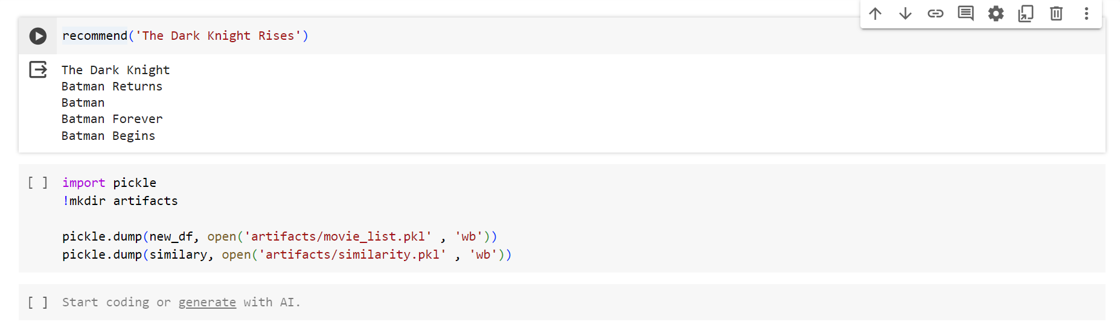
Result
Film Title
Film Name
Production Company Name
Your Company Name
Phone Number:123456789
Contact lane, USA
Contact Information

